Slide 1

Multimedia Data Management
Lecture 10 – NoSQL (MongoDB)
Fall 2022

Slide 2
Is traditional tabular data representation always the best approach?

Slide 3
What is NoSQL
NoSQL Database is a non-relational Data Management System, that does not require a fixed schema. It avoids JOIN, and is easy to scale. The major purpose of using a NoSQL database is for distributed data stores with humongous data storage needs. NoSQL is used for Big data and real-time web apps. For example, companies like Twitter, Facebook and Google collect terabytes of user data every single day.
NoSQL database stands for “Not Only SQL” or “Not SQL.” Though a better term would be “NoREL”, NoSQL caught on. Carl Strozz introduced the NoSQL concept in 1998.

Slide 4
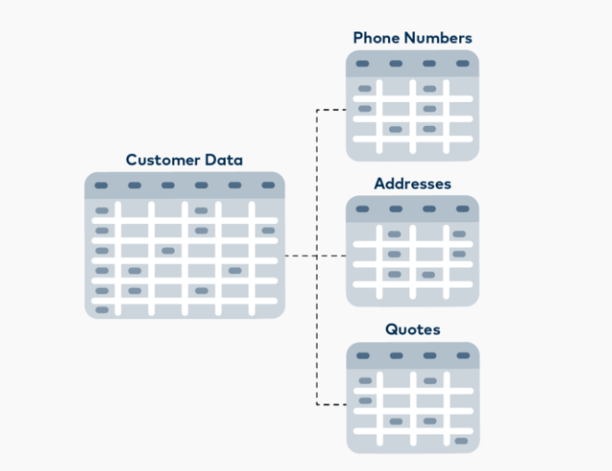
SQL Flaws Example

Slide 5
Why MongoDB

Slide 6
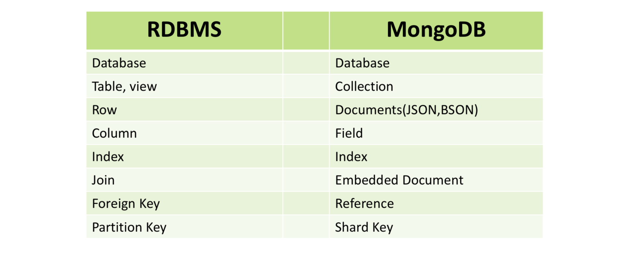
PostgreSQL vs. MongoDB

Slide 7
Starting commands
Mongosh
show dbs
use <db name>
show collections
use <collection name>

Slide 8
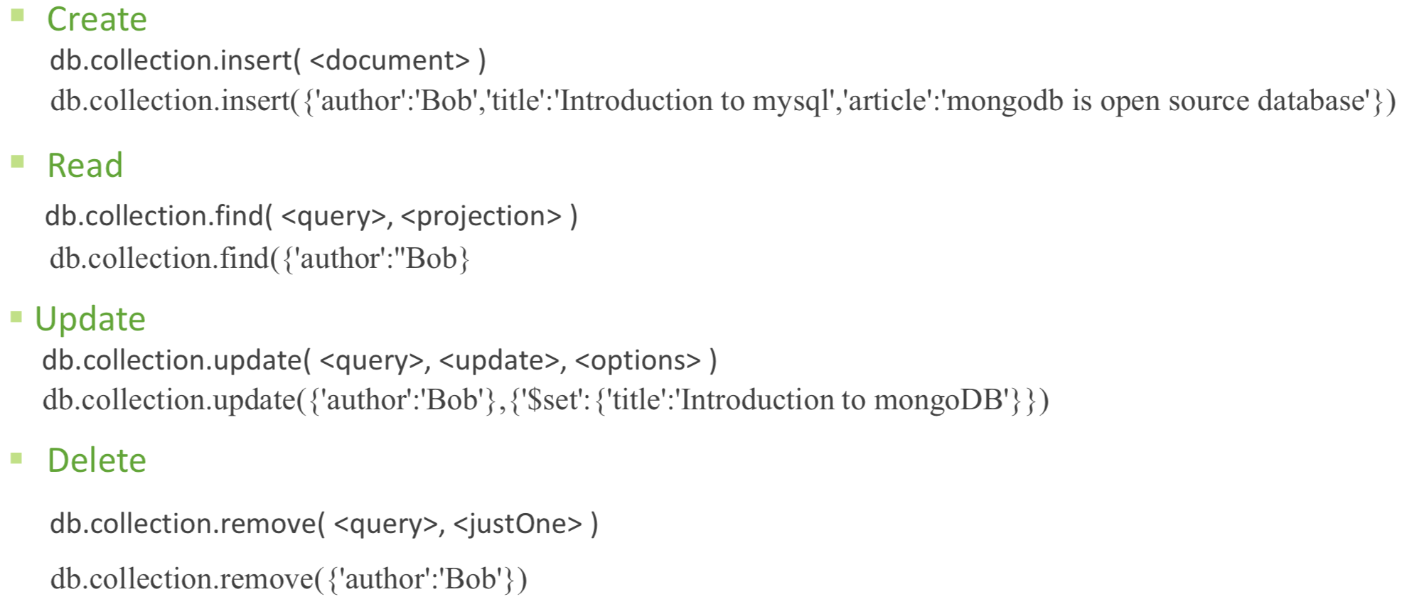
CRUD
Notes:
Insert is deprecated use insertOne or insertMany instead.
Update is deprecated use updateOne or updateMany instead.
Remove is deprecated use deleteOne or deleteMany instead.

Slide 9
CRUD - Example

Slide 10
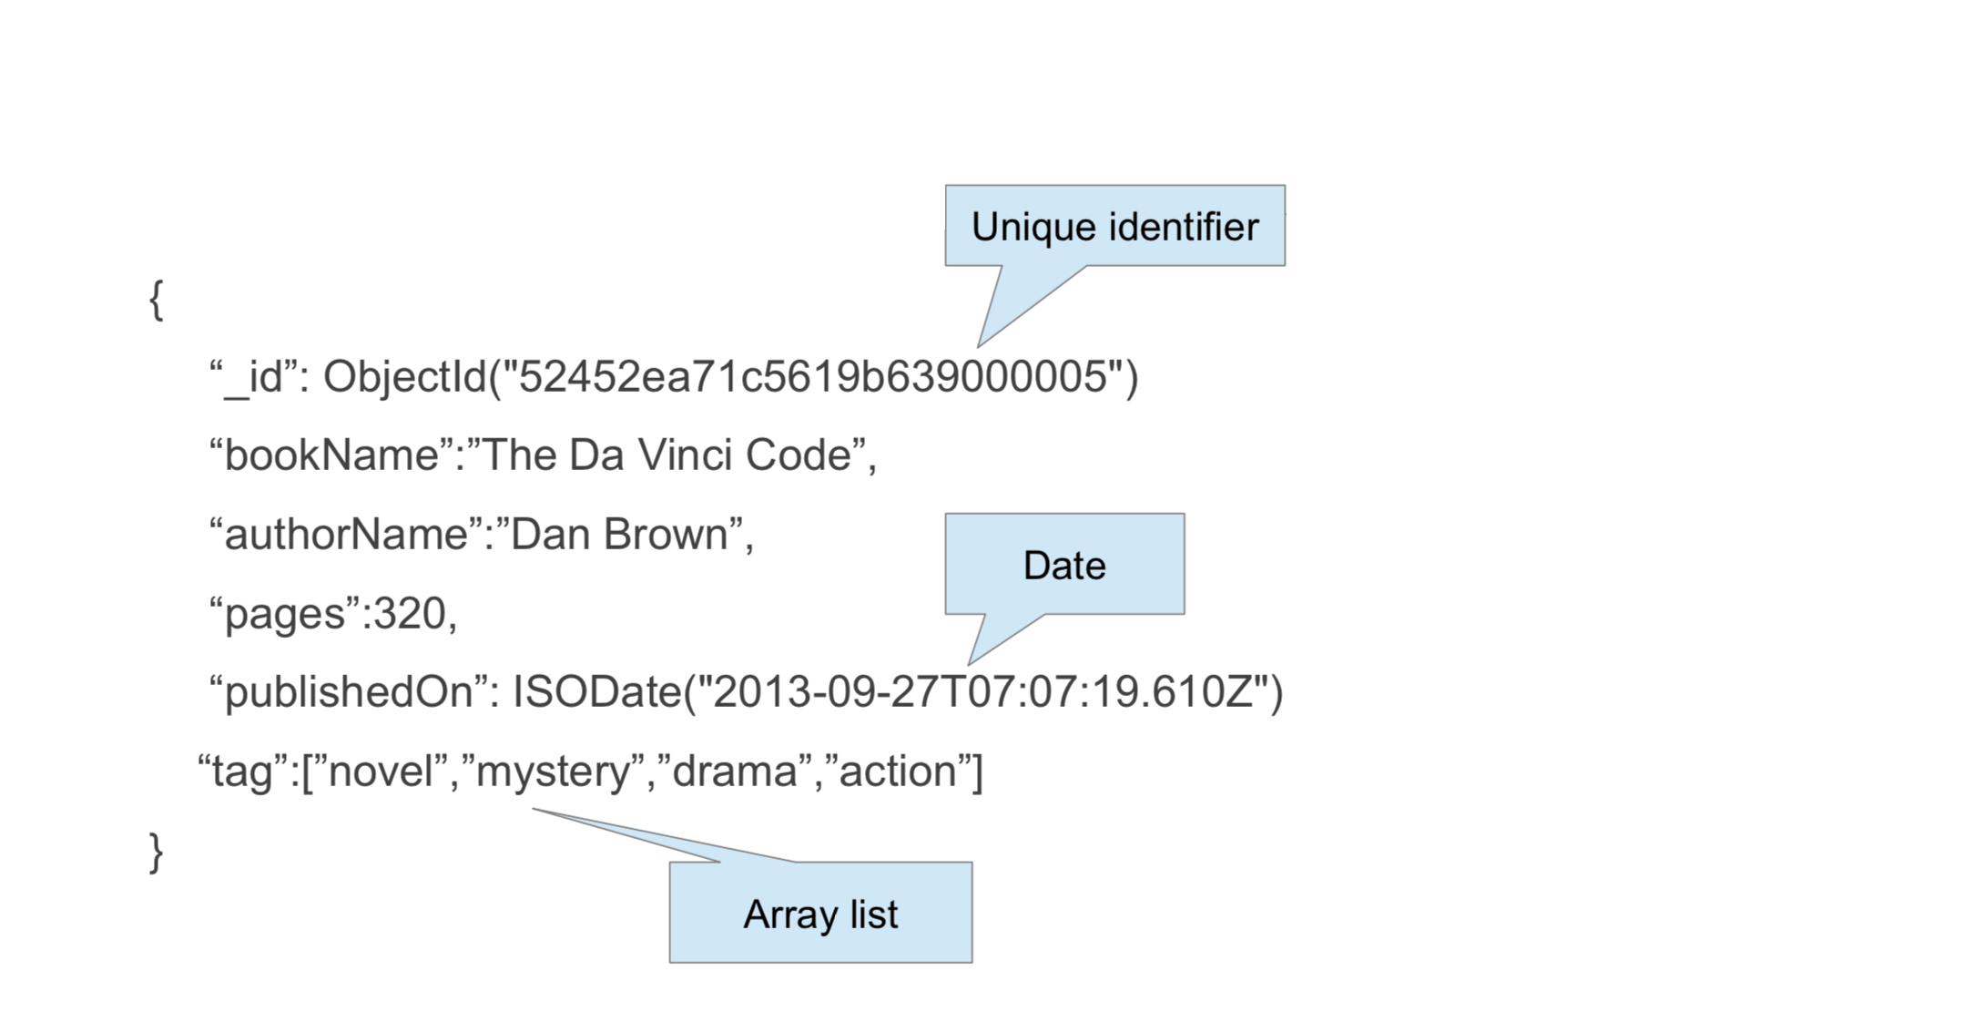
Documents

Slide 11
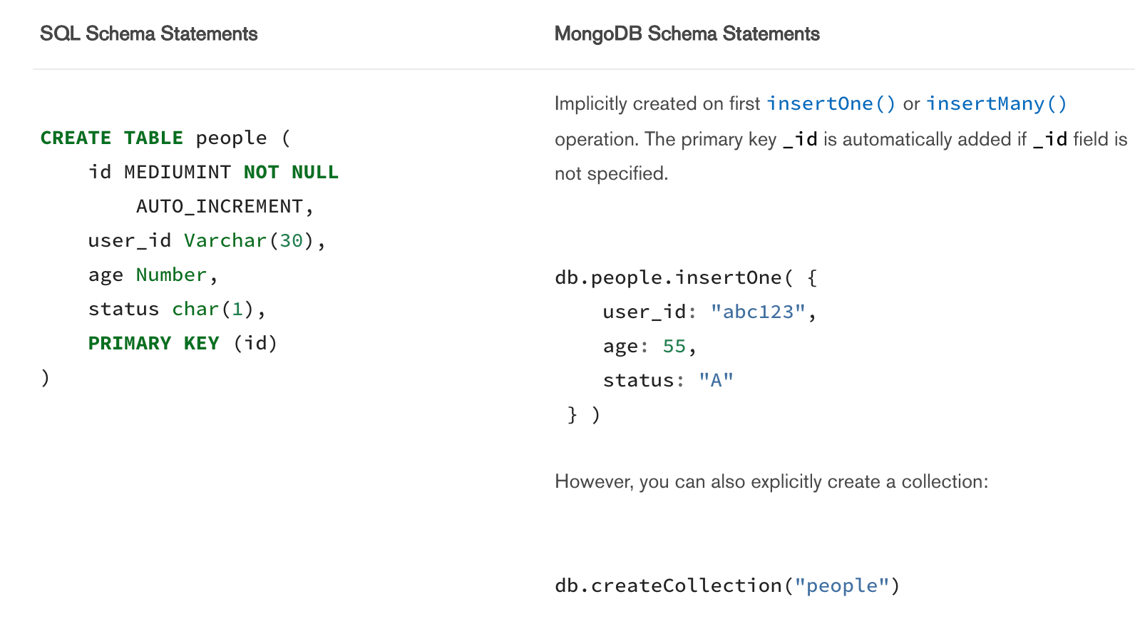
CREATE

Slide 12
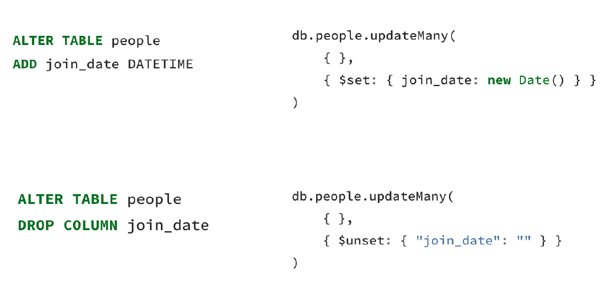
ALTER

Slide 13
DELETE
Notes:
db.people.deleteMany({})

Slide 14
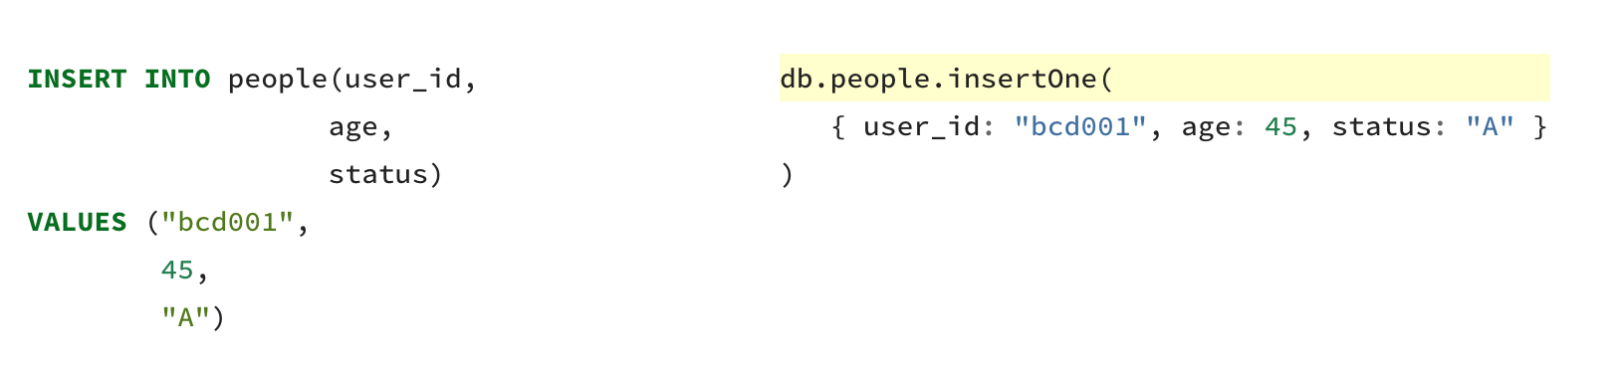
INSERT

Slide 15
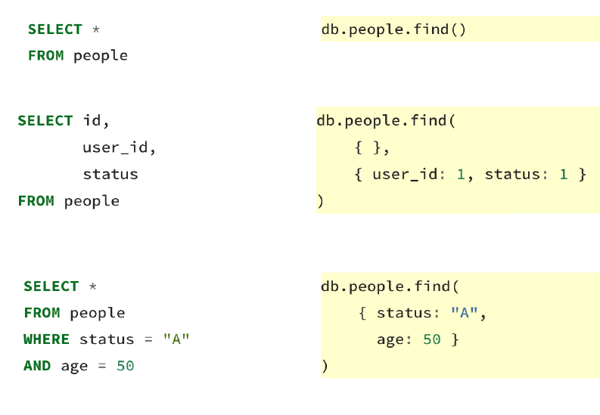
SELECT

Slide 16
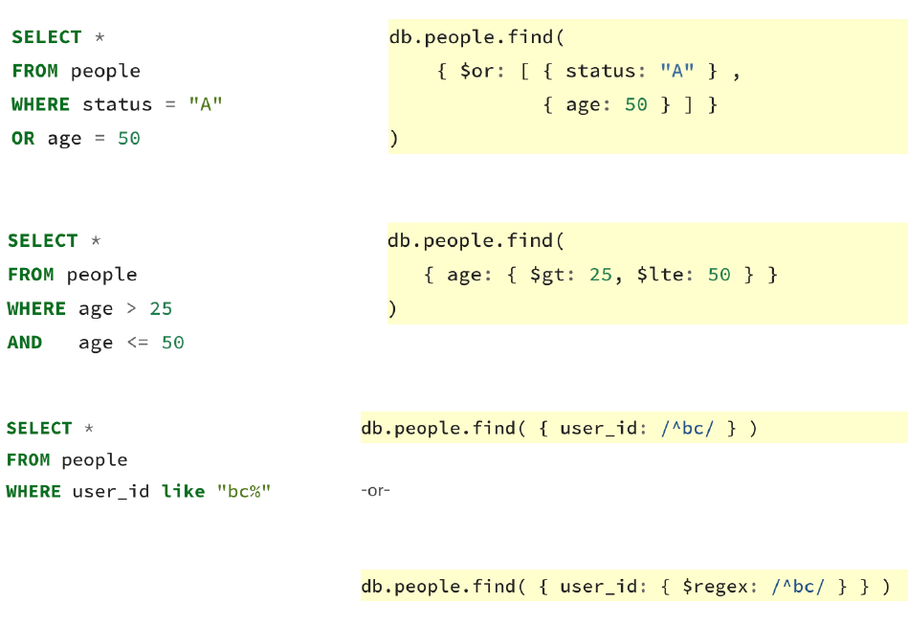
SELECT

Slide 17
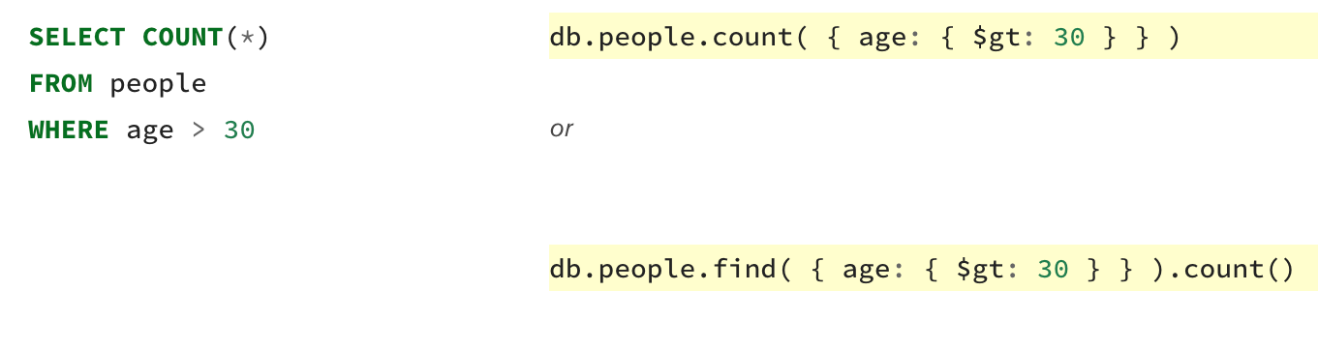
SELECT COUNT

Slide 18
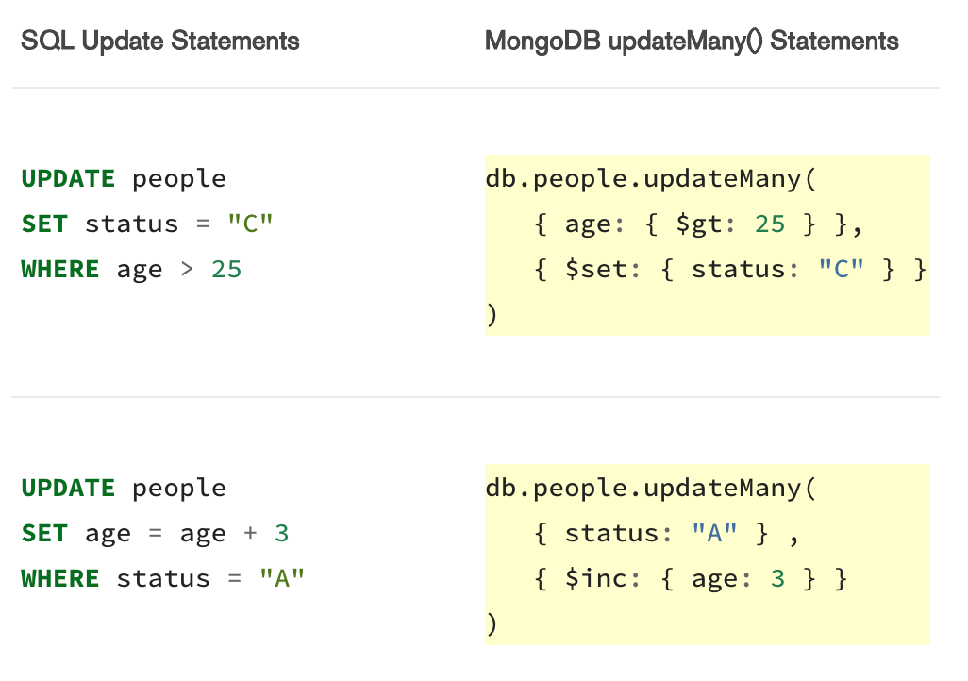
UPDATE

Slide 19
Aggregation Function Examples
Notes:
Social media

Slide 20
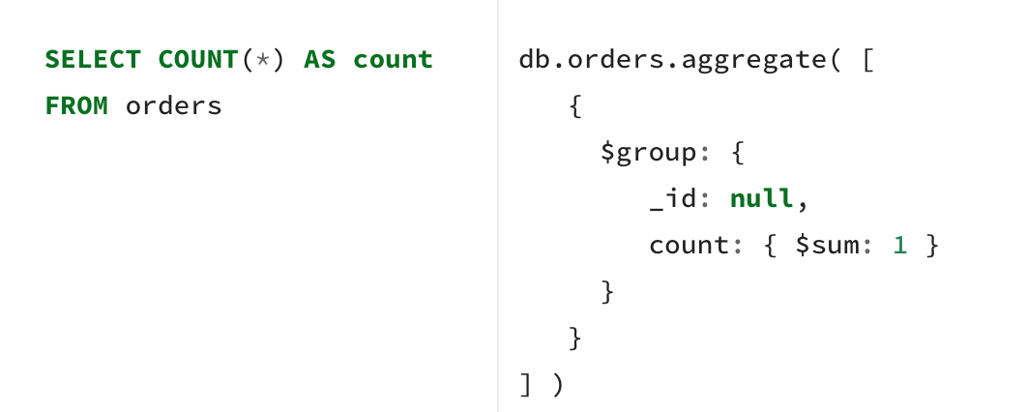
COUNT

Slide 21
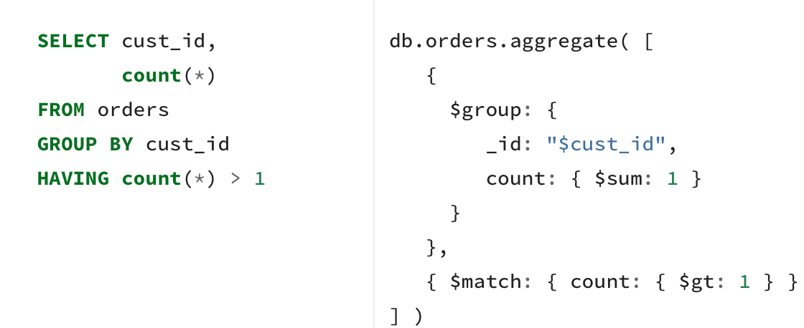
COUNT

Slide 22
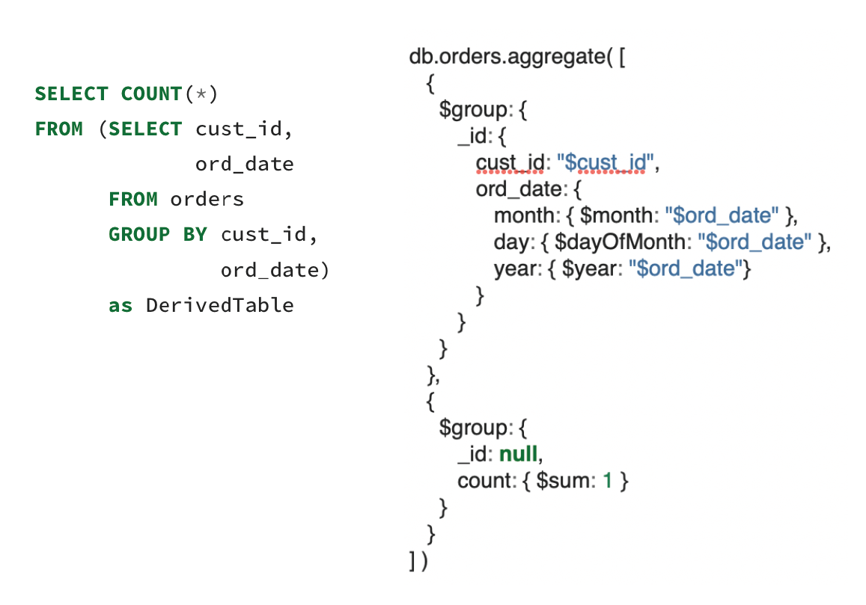
COUNT

Slide 23
SUM

Slide 24
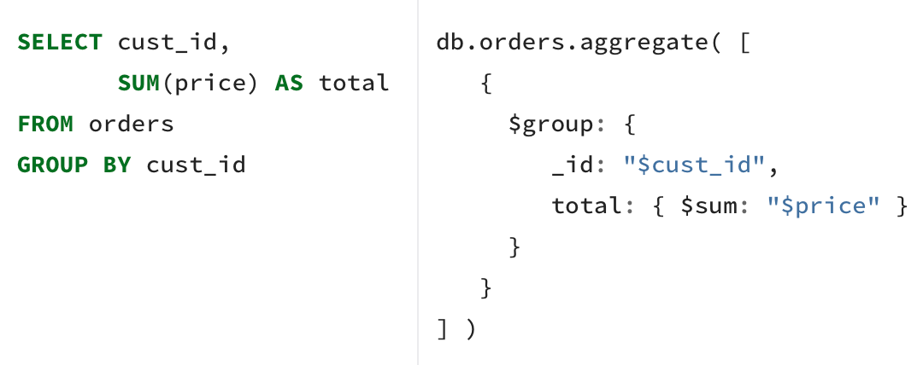
SUM

Slide 25
SUM

Slide 26
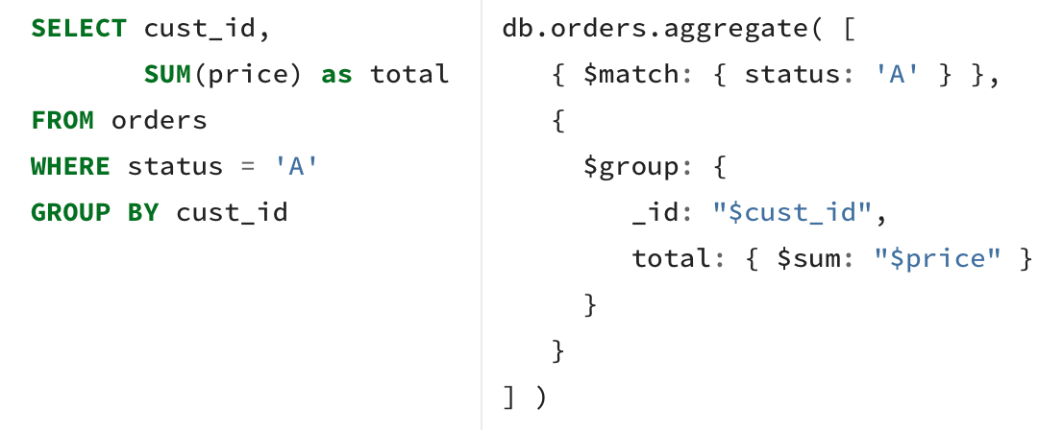
SUM

Slide 27
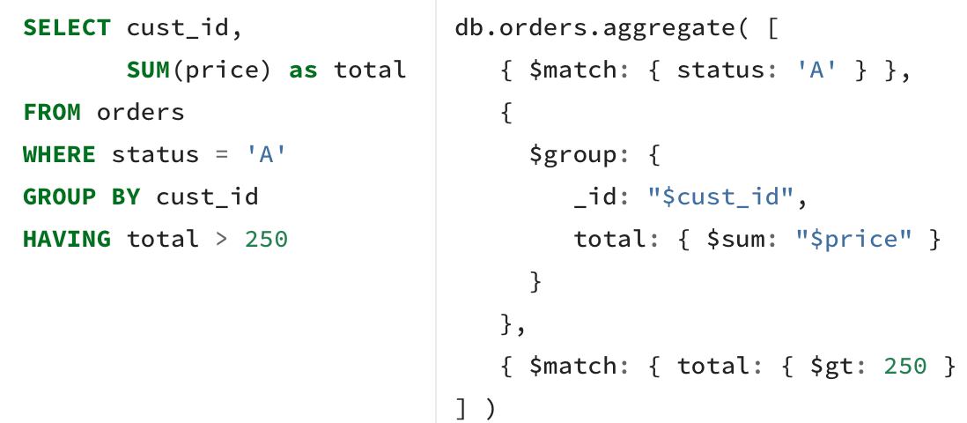
SUM

Slide 28
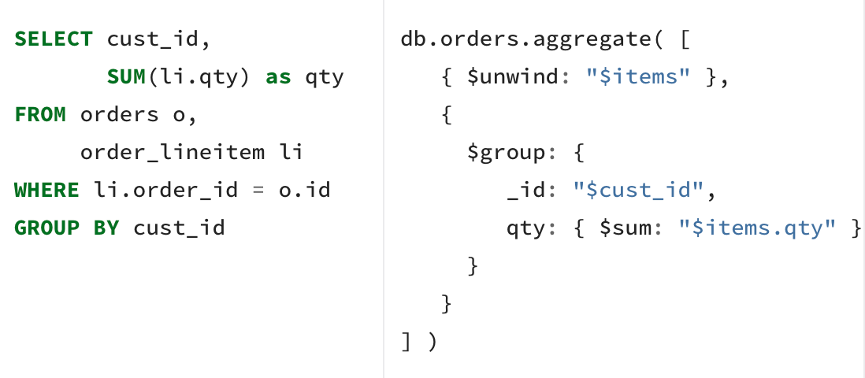
SUM

